Slide 1
A
4 hr 16 hr
C
IL-2
B
16 hr
4 hr
IL-2/TCR/CD28
Fig. 1. The IL-2 and TCR/CD28-dependent transcriptome of human Tregs. FACS-sorted CD4⁺ CD25^{hi} CD127^{lo} Tregs were cultured in media alone, with human IL-2 (100 U), anti-CD3/anti-CD28 + anti-IL-2 (TCR/CD28), or IL-2 + anti/CD3 and anti-CD28 for 4 or 16 hr. RNA was isolated from these cells and their transcriptome was determined by RNA-seq. Differentially expressed genes (DEGs; ≥1.5 fold-change up- or down-regulated, FDR<0.01) were derived from 4-6 independent samples from normal human subjects as depicted in Fig. S1 for all analyses. (A) Venn diagrams of overlapping genes. (B) Hierarchical clustering (one minus the Pearson correlation) applying K-means partitioning tool where at least one group passed our threshold (≥ 1.5-fold, FDR < 0.01). (C) Pathway analysis of up-regulated DEGs at 16 hr identified by g:Profiler (Gene Ontology Biological Processes, Reactome, and WikiPathways) and consolidated using Cytoscape.

Slide 2
A
C
B
D
Fig. 2. Screening DEGs for highly IL-2-dependent genes. (A) Plot of all up-regulated DEGs (≥3-fold, FDR <0.01) induced by IL-2 at 4 hr in relationship to their basal level of expression as represented by the read counts after culture in media for 4 hr. (B) Comparison of the IL-2-dependent DEGs in (A) in relationship to the fold-changed observed after culture with IL-2 vs. anti-CD3 and anti-CD28 in the presence of anti-IL-2 (TCR/CD28) or IL-2 vs. anti-CD3 and anti-CD28 plus exogenous IL-2 (IL-2/TCR/CD28) for 4 and 16 hr. (C) Time course of expression (read counts) of selected genes after culture with the indicated stimuli. (D) The ratio of mRNA expression by RNA-seq induced solely by IL-2 vs. anti-CD3/CD28 plus IL-2 at 16 hours after culture initiation.

Slide 3

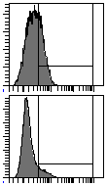
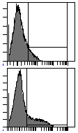
C
IL-2
anti-CD3//28
A
Treg
T_{EM}
B
IL-2
Treg
28
11
33
12
10
23
CD4⁺ T_{EM}
CEACAM1 PE
CEACAM1 PE
D
E
Fig. 3. IL-2-dependent induction of CEACAM1 is more robust in Treg than Teff cells. (A-B) Human CD4⁺ T cells (5 x 10⁻⁵) were isolated from healthy donors and were cultured with anti-CD3/CD28 and/or human IL-2, as indicated, and expression of CEACAM1 was determined by flow cytometry. (A) Treg and Teff cells were cultured for 2 days with IL-2 and CEACAM1 expression was determined; represented histogram at 100 U/ml of IL-2 (top) and quantitative data (bottom; n=3, mean ± SD). (B) Effect of anti-IL-2 on CEACAM1 expression for Treg and Teff cells after culture for 2 days with IL-2 and/or anti-CD3/CD28, as indicated (n=4; mean ± SD). (C-E) Human CD4⁺ CD25^{hi} CD127^{lo} Tregs or CD4⁺ CD45RA⁻ CD25^{med} CD127^{hi} CD4 T_{EM} cells were sorted from purified CD4⁺ T cells from healthy donors. (C) The purified T cells were stimulated at culture initiation with anti-CD3/CD28 and IL-2 or only IL-2 for 5-6 days and expression of CEACAM1 was determined by flow cytometry; representative histograms (top) and quantitative data (bottom; n=2, mean ± SD). (D, E) The purified T cells were stimulated at culture initiation with anti-CD3/CD28 and IL-2 and were sub-cultured with only IL-2 on days 3 and 6. CEACAM1 and CD25 RNA (D) and cell surface expression (E) was determined by RNA-seq or flow cytometry, respectively. RNA data are expressed as transcripts/million (TPM). Data (n=4) are represented as mean ± SD.

Slide 4
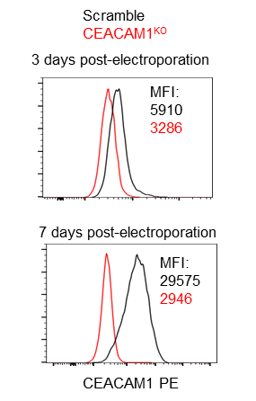
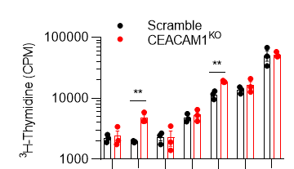
A
B
D
C
Fig. 4. CEACAM1 is a TCR checkpoint in Tregs. (A) RT-PCR of CEACAM1 mRNA where the size of long and short isoforms (197bp and 143bp, respectively) are indicated. (B-C) Tregs were stimulated with anti-CD3/CD28 and IL-2 for 3 days, electroporated with Cas9 RNP containing scramble sgRNAs or sgRNAs targeting CEACAM1, and sub-cultured with IL-2 for 7 days. (B) Representative histograms of CEACAM1 expression showing the MFIs at indicated time points. (C) In vitro suppression assay of CD8⁺ T cells (responder) by scramble and CEACAM1^{KO} Tregs (n=3; mean ± SD). (D) Scramble and CEACAM1^{KO} cells were cultured as indicated for 3 days and cell proliferation was assessed by ³H-thymidine incorporation; representative experiment (left; n=3 technical replicates; mean ± SD) and quantitative data of fold change (right; n=4 biological replicates; mean ± SD). Data were analyzed by two-way ANOVA with multiple comparisons (left) and one-sample two-sided t-test (right).

Slide 5
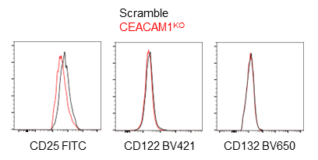
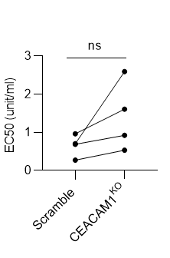
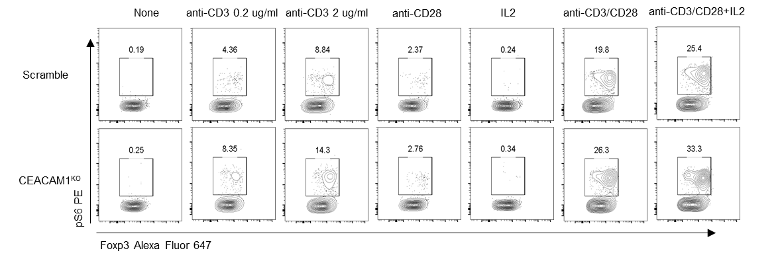
A
B
Scramble
C
Fig. 5. CEACAM1 expressing Tregs are associated with lower TCR signaling. Tregs were cultured as describes in Fig. 4. (A) Expressions of IL-2R subunits were determined by flow cytometry; representative histograms (top) and quantitative data (bottom; n=4). Data were analyzed by paired two-sided t-test. (B, C) Scramble and CEACAM1^{KO} Tregs were rested overnight and (B) were treated with IL-2 for xxx minutes or (C) as indicated for 6 hr. (B) Nonlinear regression analysis of IL-2-induced pSTAT5 (left; n=4; mean ± SD) and quantitative data of EC50 (right; n=4). (C) Representative contour plots (left) and quantitative data (right; n=3; mean ± SD) of pS6 activation. Data were analyzed by two-way ANOVA with multiple comparisons.

Slide 6
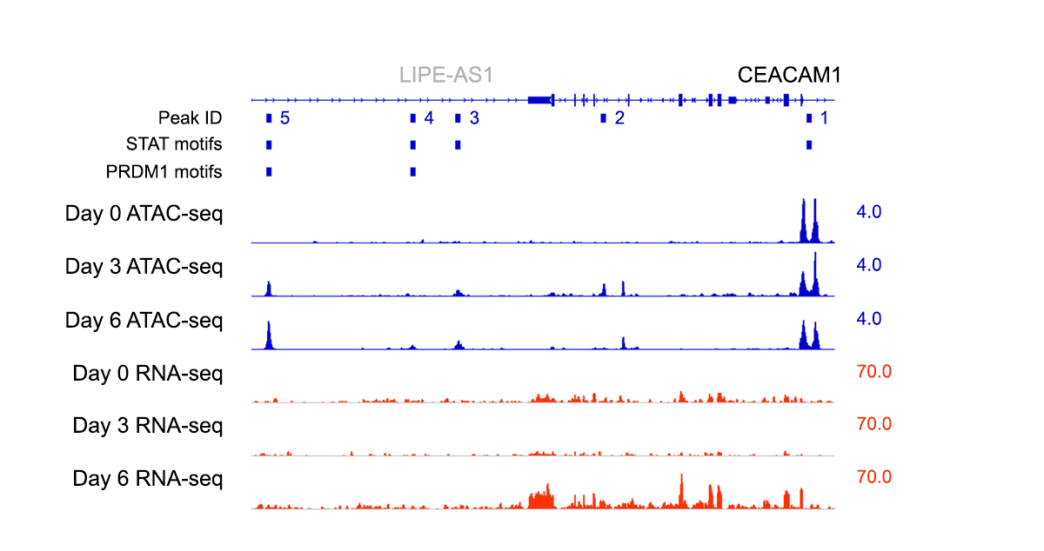

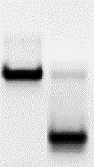
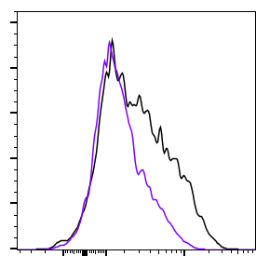
A
B
Day
C
RT-PCR
Control
BLIMP1^{KO}
BLIMP1
2-5
Scramble
BLIMP1^{KO}
Scramble
CEACAM1 PE
Fig. 6. IL-2R-dependent CEACAM1 expression depends on chromatin opening and BLIMP-1. (A, B) Purified T cells were stimulated at culture initiation with anti-CD3/CD28 and IL-2 and were sub-cultured with only IL-2 on days 3 and 6. ATAC-seq and RNA-seq was performed at the indicated times. (A) Sequence reads for ATAC-seq and RNA-seq were mapped on the genome browser for CEACAM1. Meme suite 5.4.1 was used to identify STAT and PRDM1 motifs. Peak IDs refer to regions with significant changes in sequences reads, showing peaks with STAT and PRDM1 motifs. The number to the left refer to the scale of sequence reads. (B) Significant variance of each peak on the indicated day. (C, D). Tregs were stimulated with anti-CD3/CD28 and IL-2 forr 3 days, electroporated with Cas9 RNP containing scrambled sgRNAs or sgRNAs targeting PRDM1, sub-cultured with IL2 for 7 days. (C) BLIMP1 mRNA was measured by RT-PCR. DNA sequences before sgRNA target site on exon 2 and after editing region on exon 5 were used as templates for primer design. Expected PCR product size (marked by the arrow) is 910 bp. Shown are representative data (left) and quantitative data (right; n=6; mean ± SD). Data were analyzed by one-sample two-sided t-test. (D) CEACAM1 expression was determined by flow cytometry. Shown are a representative histograms (left) and quantitative data (right). Data (n= 4) were analyzed by a paired two-sided t-test.

Slide 7
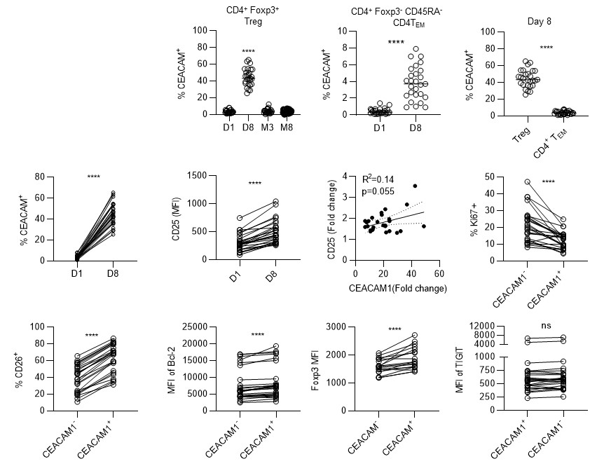
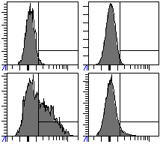
A
Treg
CD4 T_{EM}
B
D1
D8
CEACAM1 FITC
C
D
E
Fig. 7. Low-dose IL-2 upregulates CEACAM1 in Tregs from autoimmune patients: 27 patients from 8 autoimmune diseases (SLE, n=6), RA, psoriasis, CD, SC, ankylosing spondylitis, Sjogren’s Syndrome, and SSc( n=3 each for all other diseases) underwent LD-IL-2 therapy. Samples were collected prior to treatment (D1), 3 days after the 5 daily induction course of IL-2 (D8), at month 3 (M3) just prior to the biweekly IL-2 maintenance injection, and at month 8 (M8), two months after the completion of therapy. All the patients received 1 million international units (MIU)/day of hIL-2 from day 1 to day 5 (the induction period), and then every 2 weeks from day 15 to day 180 (the maintenance period). (A) Representative histogram of CEACAM1 expression in CD4⁺ Tregs or T_{EM} at the indicated time points. (B). Quantitative data of CEACAM1 expression in Tregs and CD4⁺T_{EM} from all patients. Data show the mean and were analyzed by unpaired two-sided t-test. (C) The relationship between CEACAM1 and CD25 expression. Fold change for the % of CEACAM1⁺ Tregs (left) and MFI of CD25 expression (middle) after low-dose IL-2 were calculated for the data shown in these plots. The fold change data for these two parameters were then plotted for each (right). To assess the relationship for IL-2-dependent upregulation of CEACAM1 and CD25 was assessed by linear regression analysis of the data in this plot. (D, E) Expression of the indicated markers for CEACAM1⁺ and CEACAM1⁻ Tregs on D8 to (D) assess proliferative activity or (E) other immune parameters. Data were analyzed by a paired two-sided t-test.

Slide 8



Cell sorting strategy
A B C
CD4⁺ cells
Post sort CD25^{hi} CD127^{lo} Tregs
CD127⁺ CD25^{lo/-}
91
CD127 APC
CD25^{hi}
CD127^{lo}
CD127 APC
96
Foxp3 PE
CD25 BV421
CD25 BV421
CD4 FITC
D E F
CD127⁺ CD25^{lo/-}
Post sort CD127⁺ CD25^{lo/-} CD45RA⁻ T_{EM}
CD45RA⁻
97
1.3
SSC-A
CD127
Foxp3
CD45RA
AlexaFluor 700
CD25 BV421
CD4 FITC
G
Fig. S1: Cell sorting strategy to isolate CD4⁺ Treg and T_{EM} cells. Peripheral blood CD4⁺ T cells were enriched using anti-CD4⁺ magnetic beads. CD4⁺ Tregs were obtained by sorting (A) CD4⁺ CD25^{hi} CD127^{lo} cells [≥96%⁺ post sort, (B)], which were typically >90% Foxp3⁺ (C). CD4⁺ T_{EM} cells were obtained by sorting (A) CD4⁺ CD127^{hi} CD25^{lo/-} cells (A) that were also CD45RA- (D) [≥97%⁺ post sort, (E)], which were 1-2% Foxp3⁺ (F). Quantitative data for each sample is shown in (G).

Slide 9
IL-2
IL-2/TCR/CD28
Fig. S2.. Pathway analysis of up-regulated DEGs at 4 hr identified by g:Profiler (Gene Ontology Biological Processes, Reactome, and WikiPathways) and consolidated using Cytoscape.

Slide 10

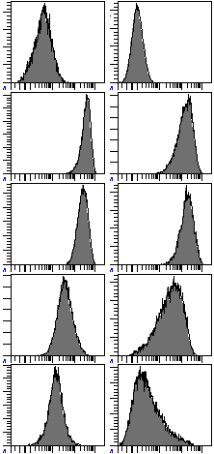
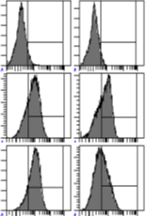
Tregs
T_{EM}
Tregs
T_{EM}
1.8
0.3
Day0
6.4
3.4
Day3
70
63
Day6
79
43
Day9
CEACAM1 PE
CD25 PE
Fig. S3. Human CD4⁺ CD25^{hi} CD127^{lo} Tregs or CD4⁺ CD45RA⁻ CD25^{med} CD127^{hi} CD4 T_{EM} cells were sorted from purified CD4⁺ T cells from healthy donors. The purified cells were stimulated at culture initiation with anti-CD3, anti-CD28, and IL-2 and sub-cultured with IL-2 on days 3 and 6. Representative CEACAM1 (left) and CD25 (right) expression was determined by flow cytometry (n=2; mean ± SD). Note: CEACAM1 and CD25 were identified in separate tubes with a distinctive flow panel

Slide 11
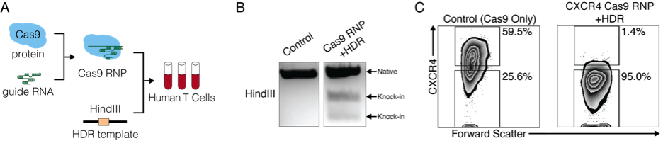
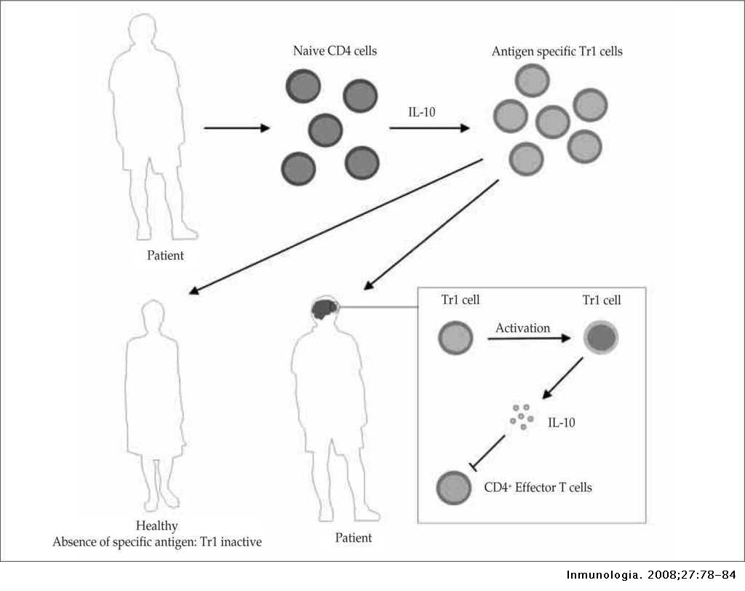
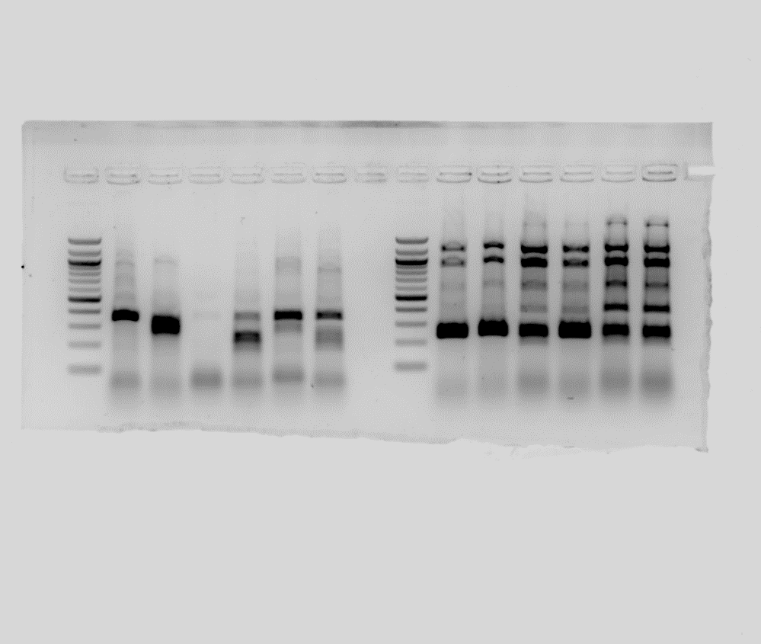
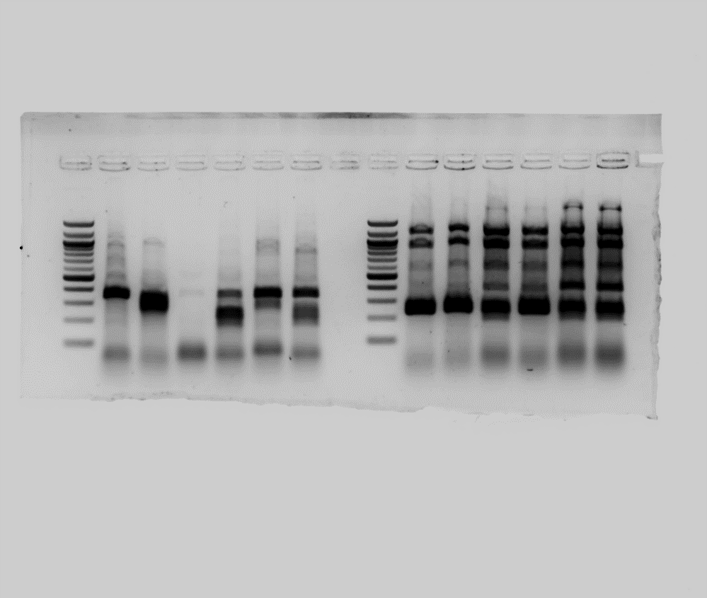
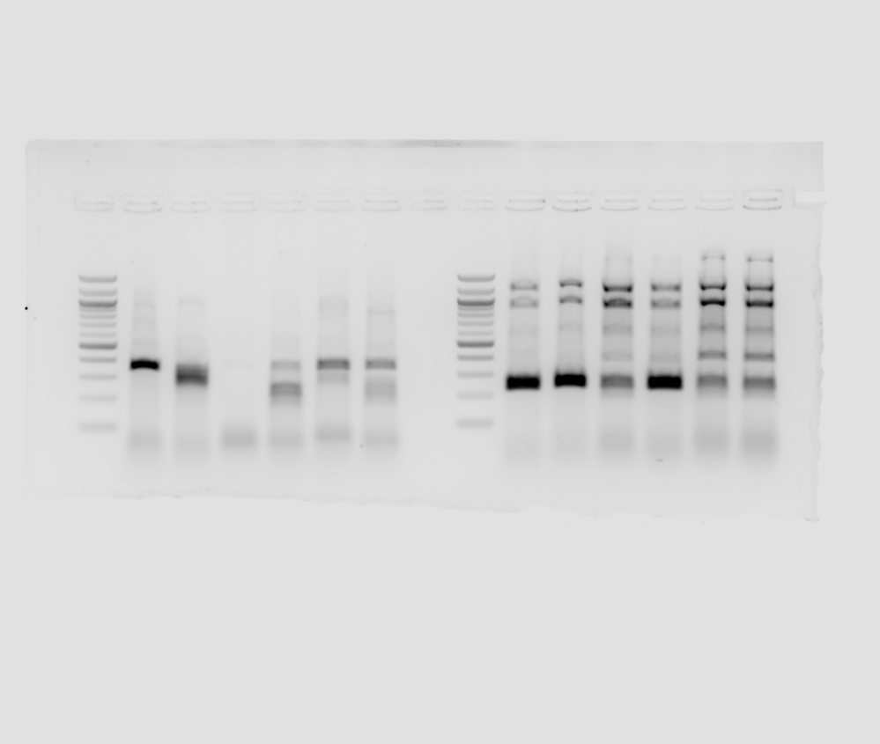
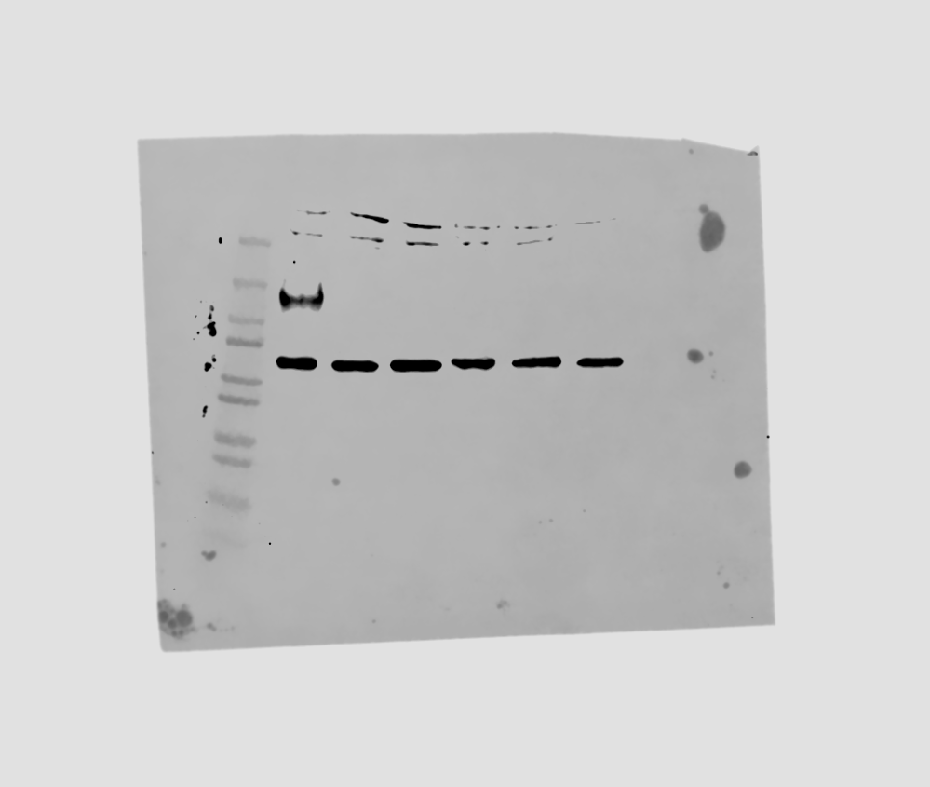
A
3:1
(Scramble/CEACAM1/BLIMP1)
Purified CD4⁺ T cells
CD4⁺CD25^{hi}CD127^{lo} Tregs
Electroporation
A
FACs
αCD3CD28+IL2
IL-2
Control/CEACAM1^{KO}/BLIMP1^{KO} Tregs
Analysis
3 days
7 days
B
gRNA1
gRNA2
Human CEACAM1
Exon
1
2
3
4
5
6
7
8
9
C
Exon 2
Exon 4
D
Control
CEACAM1^{KO}
Control
CEACAM1^{KO}
KD
Control
CEACAM1^{KO}
1000 bp
1000 bp
150
CEACAM1
100
500 bp
500 bp
75
Non-specific
400 bp
360bp
400 bp
50
300 bp
300 bp
255bp
37
200 bp
200 bp
25
100 bp
100 bp
20
50
β-actin
>98%
>69%
37
Fig. S4. Knockout of CEACAM1 in human Tregs using Crispr-Cas9. (A) Culture conditions and experimental scheme. (B) Dual-target knockout strategy for CEACAM1. Two sgRNAs targeting exon 2 and exon 4 were designed to increase knockout efficiency. (C) T7 endonuclease I (T7EI) assay of gene editing in exon 2 and exon 4 of CEACAM1. Expected PCR product size and knockout efficiency are indicated. (D) CEACAM1 expression was determined by immunoblotting in scramble and CEACAM1^{KO} Tregs.

Slide 12
Fig. S5. Biological replicates of proliferation assay assessed by ³H-thymidine incorporation. Data with each experiment were analyzed by two-way ANOVA with multiple comparisons (mean ± SD in each experiments show technical replicates). These data and the experiments shown is Fig. 4D (top) were used to determine the fold-change for each of the four biological replicates Fig. 4D (bottom).

Slide 13
gRNA1
gRNA2
Human PRDM1
Exon
1
2
3
4
5
6
7
Fig. S6. Strategy for PRDM1 knockout in human Tregs using Crispr-Cas9. (A) Two sgRNAs targeting exon 2 and exon 5 of human PRDM1 were used in Crispr-Cas9.

Slide 14
Fig. S7. Quantitative data of CD25 expression in CD4⁺T_{EM} from all patients. Data were analyzed by unpaired two-sided t-test.

